Slide 1
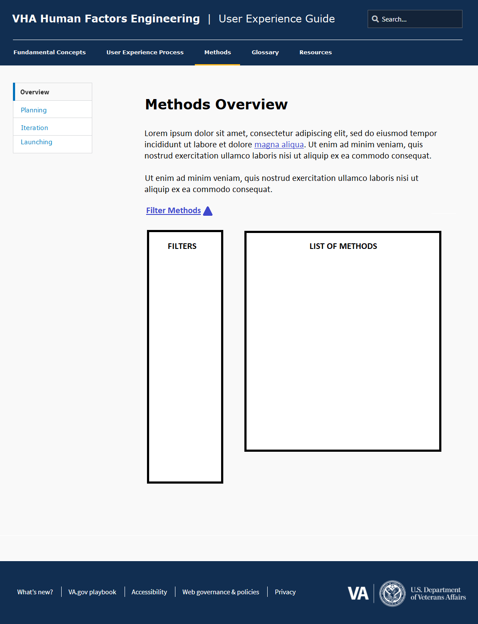
The Filter module and resulting
list of Methods would appear
within the VA.gov styled templates
as shown here. Note that the style
is only a guideline and not a
specification, so gaps like the one
indicated can be reduced.

Slide 2
PROJECT PHASE
PLAN
Plan
ITERATE
Understand
Specify
Produce
Evaluate
LAUNCH
Launch
List of Unfiltered Methods and their Primary Properties
(e.g., 29 Methods)
All Methods page:
Filter Methods, default view
Filter subgroups (e.g., Plan, Iterate, Launch)
PENDING: IA, wireframes and visual design
of Methods as they appear on All
Methods page
REQUIRED EXPERTISE
High
Medium
Low
LEVEL OF EFFORT
High
Medium
Low
STATE OF CURRENT DESIGN
No design
Page design
Interactive prototype
Application in development
Live application

Slide 3
PROJECT PHASE
PLAN
Plan
ITERATE
Understand
Specify
Produce
Evaluate
LAUNCH
Launch
X Iteration: Specify
X Iteration: Produce
X Low Level of Effort
X Interactive Prototype
List of Filtered Methods and their Primary Properties
(e.g., 11 Methods)
All Methods page:
Filter Methods, view 2
Current filters (e.g., “X Veteran”) are ordered to
match how they appear in the filters module
Current filters within subgroups (e.g., “X Iteration: Specify”)
include both the subgroup name and the specific
value.
REQUIRED EXPERTISE
High
Medium
Low
LEVEL OF EFFORT
High
Medium
Low
STATE OF CURRENT DESIGN
No design
Page design
Interactive prototype
Application in development
Live application

Slide 4

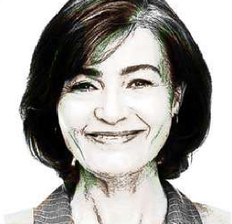


ROLE
Veteran
Caregiver
VA Clinician
VA Staff
VETERAN’S SERVICE ERA
Post-911
Vietnam
WW II & Korean War
TECHNOLOGY ADOPTION
Mainstream
Early Adopter
Late Adopter
SOURCE
US Department of Veteran Affairs
Veterans Health Administration
National Institutes of Health
Cynthia
Role: Veteran
Service Era: Post 9/11
Patient Condition(s): Diabetes, Hypertension, and Respiratory,
Neurological, & Autoimmune Symptoms
Technology Adoption: Mainstream
Source: Veterans Health Administration, Office of Health Informatics, Human Factors Engineering (HFE)
Details
All Personas page:
Filter Personas, February, default view
Filter values sometimes higher level than
object properties on tile (e.g., “VA
Clinician” vs. “VA Clinician -
Gastroenterologist”
NOTE: order of Source values switched
from general to more specific
Lack of dependent filters (e.g., Service Era) –
consider this post-February
Some properties on tile that aren’t in
filters (e.g., Patient Conditions)
Open/close filter module?
Click anywhere on tile?
PENDING: Visual design of Persona tiles
Radiobuttons vs. checkboxes: only checkboxes
needed for now
Strength of Evidence not tile-worthy?
Assume Boolean OR
Anna
Role: Caregiver - Family Member
Service Era: Post 9/11
Patient Condition(s): Traumatic Brain Injury (TBI)
Technology Adoption: Early Adopter
Source: US Department of Veterans Affairs, Enterprise Veterans Self Service (EVSS)
Details
Debra, MD, FACG
Role: VA Clinician - Gastroenterologist
Technology Adoption: Early Adopter
Source: Veterans Health Administration, Office of Health Informatics,
Human Factors Engineering (HFE)
Details
Kristen
Role: VA Clinician - Nurse
Technology Adoption: Mainstream
Source: Veterans Health Administration, Office of Health Informatics,
Human Factors Engineering (HFE)
Details

Slide 5
ROLE
Veteran
Caregiver
VA Clinician
VA Staff
VETERAN’S SERVICE ERA
Post-911
Vietnam
WW II & Korean War
TECHNOLOGY ADOPTION
SOURCE
US Department of Veteran Affairs
Veterans Health Administration
National Institutes of Health
X Veteran
X Veterans Health Administration
All Personas page:
Filter Personas, February, view 2
Cynthia
Role: Veteran
Service Era: Post 9/11
Patient Condition(s): Diabetes, Hypertension, and Respiratory,
Neurological, & Autoimmune Symptoms
Technology Adoption: Mainstream
Source: Human Factors Engineering (HFE), Office of Health Informatics, Veterans Health Administration
Details
In this example, if Source did not equal VHA,
then the resulting tiles would be zero … we will
need to cover that scenario.

Slide 6
All Personas page:
Persona labeling and [properties]
[Name]
Role: [Role]
Service Era: [Era]
Patient Condition(s): [Conditions]
Technology Adoption: [Technology]
Source: [Source]
Details
[Headshot]

Slide 7
ROLE
Veteran
Caregiver
VA Clinician
VA Staff
VETERAN’S SERVICE ERA
Post-911
Vietnam
WW II & Korean War
TECHNOLOGY ADOPTION
SOURCE
US Department of Veteran Affairs
Veterans Health Administration
National Institutes of Health
X VA Clinician
X VA Staff
All Personas page:
Filter Personas, post-February, default view
Debra, MD, FACG
Role: VA Clinician - Gastroenterologist
Technology Adoption: Early Adopter
Source: Human Factors Engineering (HFE), Office of Health
Informatics, Veterans Health Administration
Details
Dependent filters (e.g., Service Era)
Kristen
Role: VA Clinician - Nurse
Technology Adoption: Mainstream
Source: Human Factors Engineering (HFE), Office of Health
Informatics, Veterans Health Administration
Details

Slide 8
ROLE
Veteran
Caregiver
VA Clinician
VA Staff
VETERAN’S SERVICE ERA
Post-911
Vietnam
WW II & Korean War
TECHNOLOGY ADOPTION
Mainstream
Early Adopter
Late Adopter
SOURCE
US Department of Veteran Affairs
Veterans Health Administration
National Institutes of Health
X Veteran
X Veterans Health Administration
All Personas page:
Filter Personas, post-February, view 2
Cynthia
Role: Veteran
Service Era: Post 9/11
Patient Condition(s): Diabetes, Hypertension, and Respiratory,
Neurological, & Autoimmune Symptoms
Technology Adoption: Mainstream
Source: Human Factors Engineering (HFE), Office of Health Informatics, Veterans Health Administration
Details

